Slide 1
Sign Language

Slide 2
Team ID : 17

Slide 3
Team members :-
Asmaa AbdElnasser Amen Mahmoud 162021057
Asmaa Mostafa Tawfik 162021058
Hanaa Mahmoud AbdelAleem 162020718

Slide 4
Description :-
According to the World Federation of the Deaf, there are approximately 72 million deaf people worldwide. So we decided to do project for sign language to help them .
We have done a project to identify three different words in American Sign Language using MediaPipe , OpenCV and Tensorflow with Dataset.

Slide 5
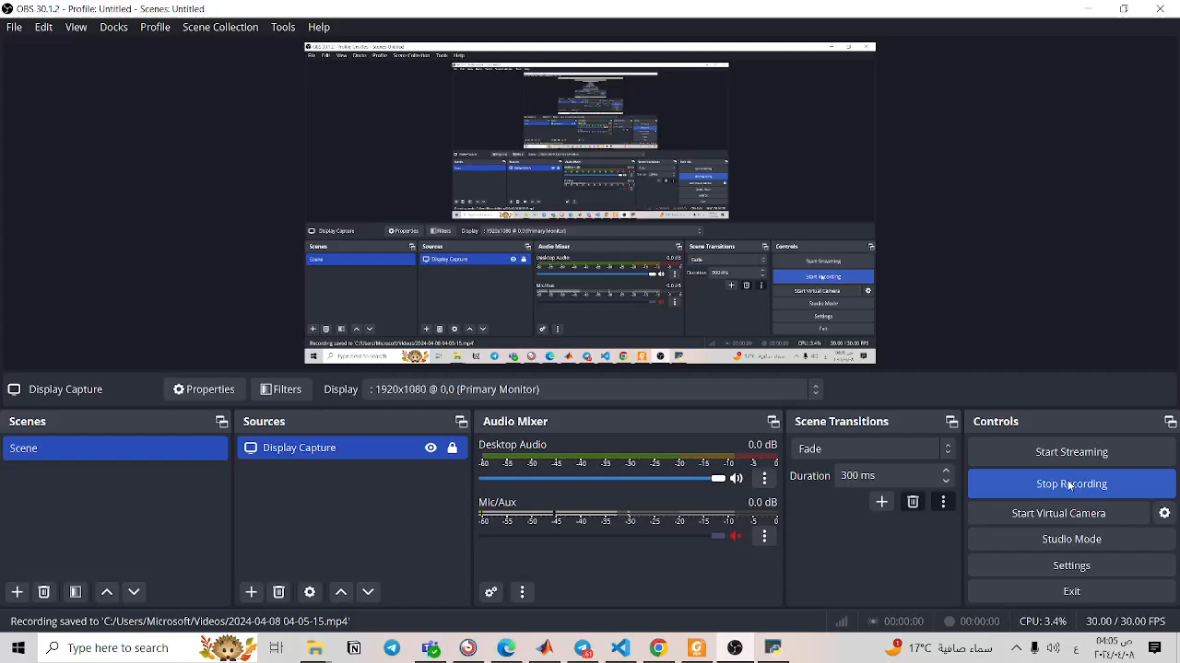
Demo :-

Slide 6
Contribution :-
We downloaded Dataset from Kaggle web site.
We have tried LSTM, DENS layers, and relu activation function .
We tried increasing the complexity of our model by adding more LSTM layers, increasing the number of units in each layer, adding more Dense layers.

Slide 7
Contribution :-
We applied dropout regularization to LSTM and Dense layers.
We add Batch normalization layers after each LSTM and Dense layer.
We changed the activation function to tanh.

Slide 8
Data :-
We downloaded Dataset from Kaggle web site .
We used 1760 photo for each sign .
We added code to transfer the extention of photos to .npy extention to train the model on them .

Slide 9
Project architecture :-
import Necessary packages
Load Photos for dataset
Extract Keypoints
Making Folders for dataset
Update origin data photos with npy extention and load them to dataset folder
Create Labels
Initialize MediaPipe Holistic model
draw landmarks
Build And train LSTM neural network
Make Predictions & Save Weights
Confusion Matrix and accuracy
Test

Slide 10
Methods :-
import Necessary packages
Initialize MediaPipe Holistic model
draw landmarks :-
- the first function make detections
- the second function draw the contours of the left hand and right
hand position on the image.
- the third function is to specify the color, thickness, and radius of
the circles representing landmarks.

Slide 11
Methods :-
Load Photos for dataset :-
the code loads images from a specified directory, processes them
using MediaPipe library for holistic detection, displays the results
with landmarks drawn on them, and waits for a key press before
moving on to the next image.
Extract Keypoints :-
segment processes the detected pose, left hand, and right hand
landmarks, extracts keypoints from them, and saves the
keypoints to a file. It also provides functionality to load the keypoints
back from the file

Slide 12
Methods :-
Make Folders for dataset :-
we make the folder of dataset and inside it we make three folders
for each word.
Update origin data photos with .npy extention and load them to dataset folder :-
the code is to iterate over folder of origin data to convert the
images extention to .npy extention to use them to train the model .

Slide 13
Methods :-
Create Labels :-
prepares data for a classification task by loading sequences of data
from files, creating corresponding labels, converting them into
numerical format, and splitting the data into training and testing
sets. Finally, it prints the shapes of the training and testing data
arrays for verification .

Slide 14
Methods :-
Build And train LSTM neural network :-
compiles, trains, and summarizes a sequential RNN model for a
multi-class classification task. It utilizes LSTM layers for sequence
processing, dropout regularization for preventing overfitting, and
batch normalization for stabilizing training. The model is trained
using the Adam optimizer and categorical cross entropy loss function
and tanh activation function.

Slide 15
Methods :-
Make predictions and save weights :-
segment predicts the action label for the fourth sample in the testing
data using the trained model and compares it with the true action
label. It then retrieves the action labels corresponding to the highest
predicted probability and the highest true label value, allowing for
analysis of the model's performance on the test data .
then save weights : loads the weights of a previously saved model
from the HDF5 file 'action.h5' into the current model.

Slide 16
Methods :-
Confusion Matrix and accuracy :-
segment evaluates the performance of a model on the testing data
by calculating the multilabel confusion matrix and accuracy score.
The multilabel confusion matrix provides detailed information about
the model's predictions across multiple classes, while the accuracy
score provides a single metric summarizing the overall classification
performance.

Slide 17
Methods :-
Test :-
this is to test the result by opening the camera and doing signs to
check the output.

Slide 18
Results :-
The result is a real-time gesture recognition system that combines keypoint detection with machine learning classification to interpret human gestures from a webcam feed.
It provides a practical example of using deep learning techniques for
gesture recognition applications .
The model recognizes three signs with an accuracy of 75 percent
The results were satisfactory.

Slide 19
GitHub :-
https://github.com/hanaa-mahmuod/sign-language.git

Slide 20


